Slide 1
Music Classification
Jonathan Gomez Martinez
Ragip Gürlek

Slide 2

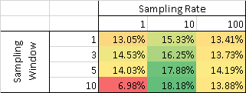
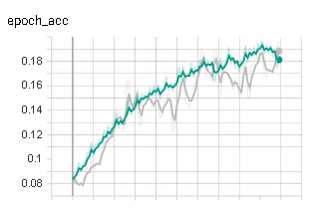
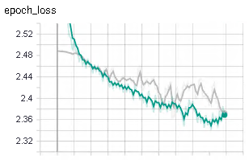
Data as a Hyper-parameter
Sampling window duration (quantity)
Sampling frequency (quality)
Fixed number of samples from tracks
LSTM 16 → LSTM 32 → Dense 16 → Output
  9,870 trainable parameters

Slide 3
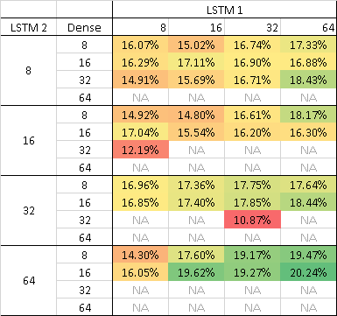
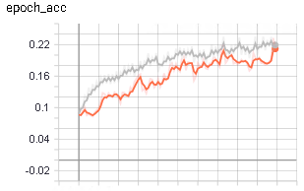
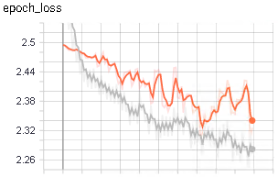
Architecture Tuning
Fixed data (10 sec, 10 samples/sec)
Early layers matter
  Dimensionality Increase

Slide 4
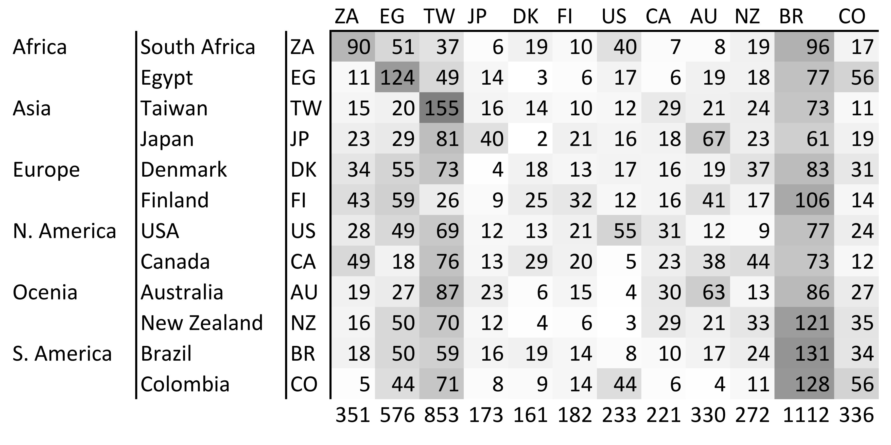
Conclusion
Garbage in, garbage out
Early layers matter
Increasing dimensionality does not cause overfitting

